Slide 1
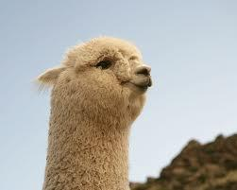
Alpaca
A romantic partner review system
Wei, Eric, Minshu, Pasin
04/17/2013

Slide 2
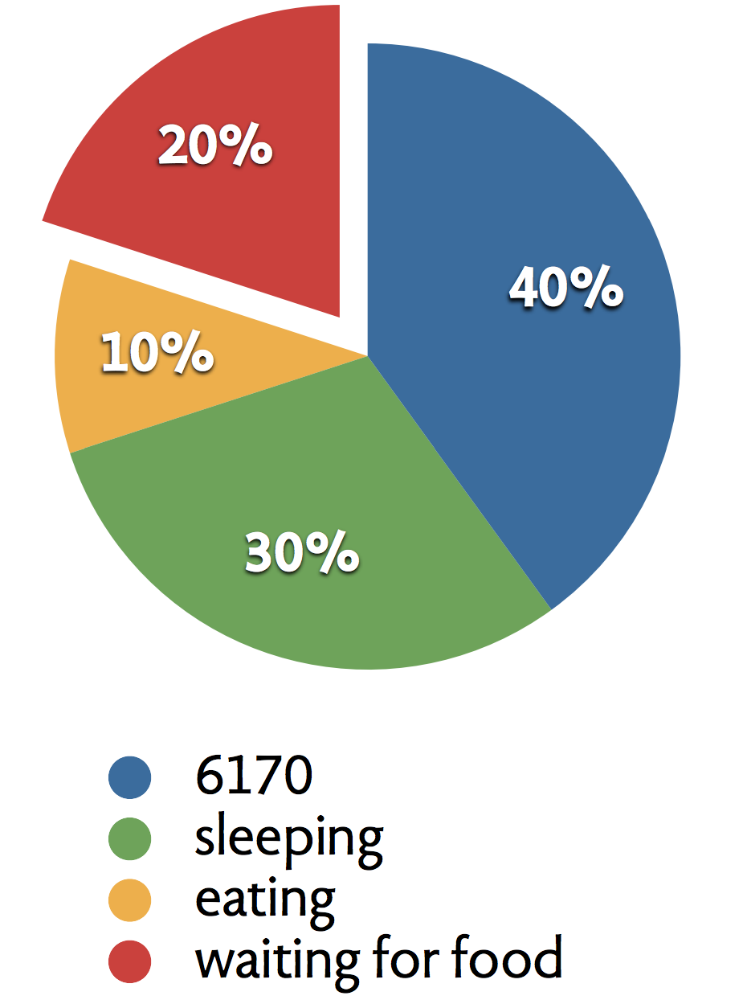
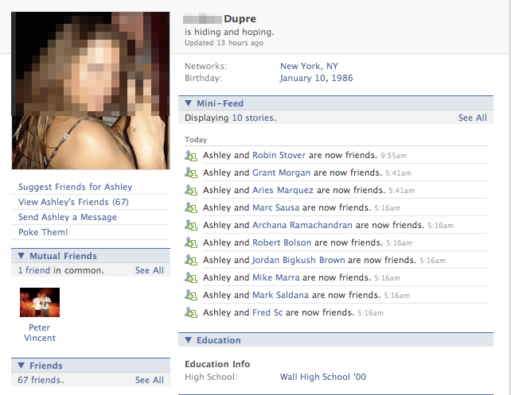
The Problem
Stalking social media profiles:
- strongly biased to favor the stalkee
- personal information unavailable
stalking on facebook etc
Notes:
due to lack of time & communication barriers we often look for bf/gf by stalking; however terribly inefficient & inaccurate
("hey i just can't get this code to work... can u take a look for me please?" "oh just go through the tutorial 4 and you'll be fine..." "...")

Slide 3
Alpaca
A romantic partner review system
Notes:
ideally we'd have a website just like yelp and glassdoor but for boyfriends and girlfriends

Slide 4
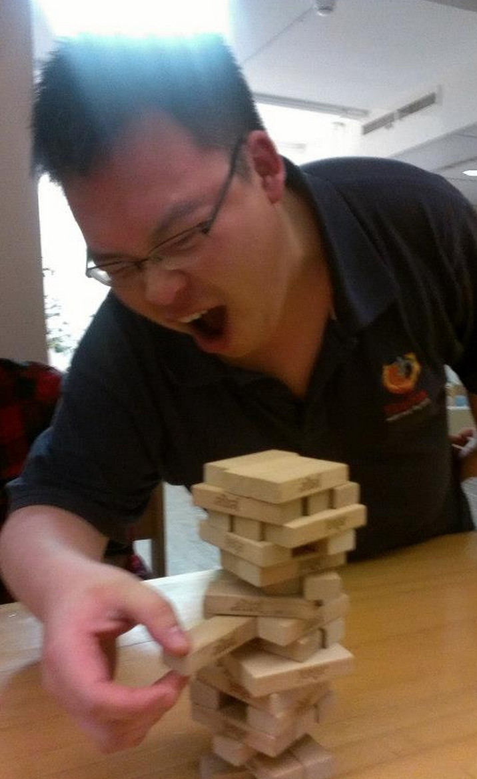
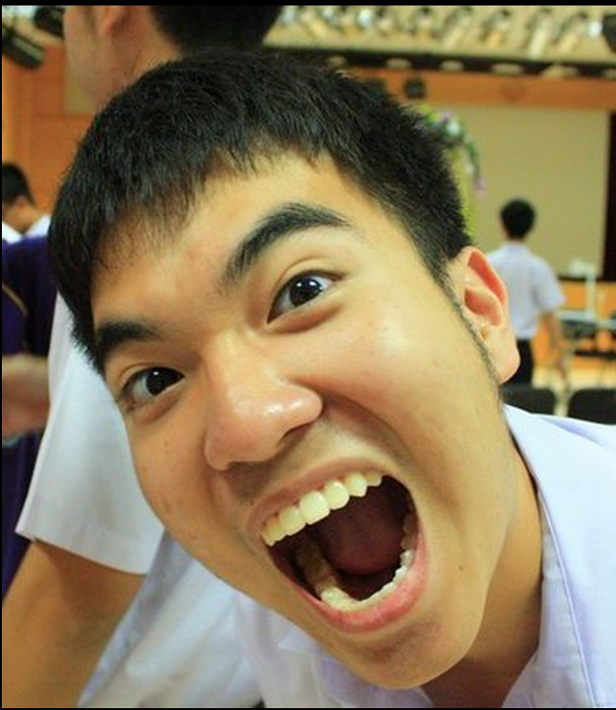

Wireframe
anonymous: he's good in bed
anonymous: agree
anonymous: he doesn't pay for anything!
anonymous: he smells
anonymous5: he's a carnivore
Notes:
collection of prestigious personal info which makes partner hunting a lot more efficient and fun!

Slide 5
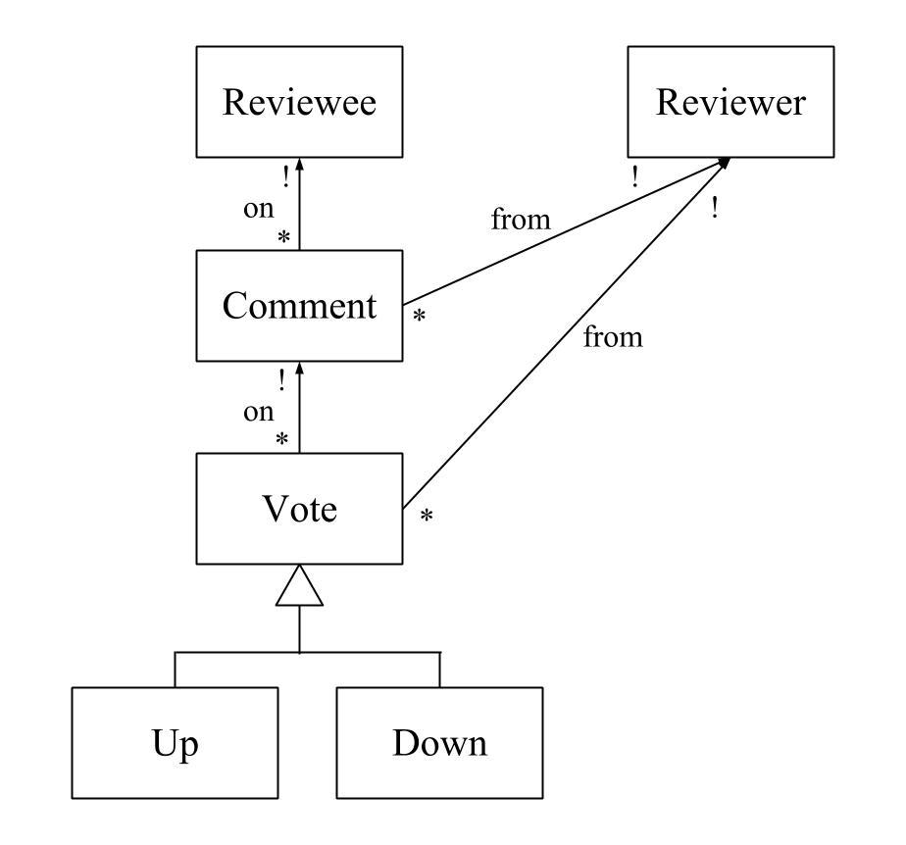
Object Model
Concepts
reviewer: the person can review
comment: comment on a reviewee
vote: vote up or vote down on a comment

Slide 6
Object Model
Features
Review Friends
Vote up/down comments
Search
Challenges
Anonymity of users

Slide 7
Risks
Design risks
Spam/fake reviews put off users
Require reviews to be Facebook friends with reviewees at minimum
Implementation risks
Facebook API technical issues
Other risks
Too offensive? (Alpaca might be too awesome for some people)

Slide 8
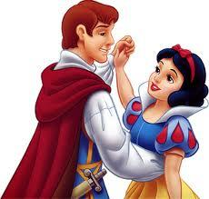
The prince and princess have lived a happy life ever after.

